Slide 1

This Photo by Unknown Author is licensed under CC BY-SA

Slide 2
Zeeshan Asghar (B210317003)
Hamza Afzal (B210317034)

Slide 3
Chatbot for Car Price Prediction
Introduction
Problem Definition
Model Selection
Implementation

Slide 4
Introduction
Train a model that kind of deal with car price prediction queries.
Second phase is also Train on pictures.

Slide 5
Problem Definition
People who are interested in price of the cars don’t know the actual price of the cars and fuel engine type like either the car is petrol vehicle or diesel vehicle.

Slide 6
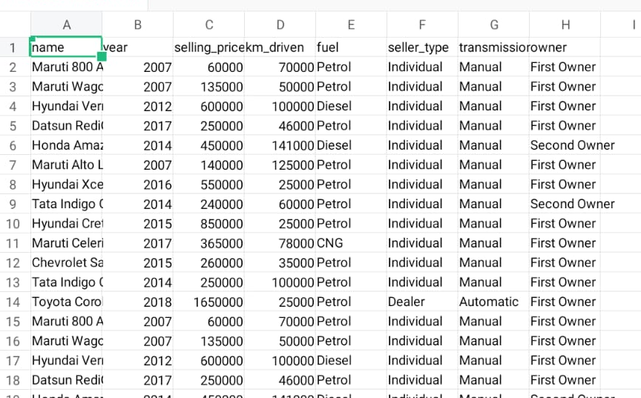
Model Selection
It rely on combination of different algorithms and neural networks models to perform the different function properly.
The data set we are taking is from Indian vehicles. (Noisy data)

Slide 7
Implementation
We implement this project in python.
Libraries and Frameworks:
pandas, numpy, os, matplotlib, Keras model

Slide 8
Any Question…??

Slide 9
Thank you

